Slide 1
Secondary Data analysis with EHR data
Alec Chapman
Notes:
Other titles:
Pandora's Box:
Journey to the Center of the EHR: Leveraging Natural Language Processing for Population Health Research
Breaking Below the Surface:
Reading Between the Lines: Applying...
Looking Under The Hood:

Slide 2
overview
About me
The note
Relational Databases
MIMIC database with SQL
1. Overview of SQL
2. Aggregating EHR data
3. Patient diagnoses
4. (if time) Labs/vitals or NLP

Slide 3



About me
PhD Student, Biostatistics, Department of Population Health Sciences
Data Scientist, University of Utah Division of Epidemiology/Department of Veterans Affairs

Slide 4
My work
Using electronic health records to answer questions like…
What is the effect of a VA homeless program on long-term housing instability?
Did an oral care intervention reduce the risk of hospital-acquired pneumonia?
What is the prevalence of Covid-19 in the national VA system?
Data sources
Clinical notes (NLP)
Diagnosis codes
Labs/vitals
… and many more

Slide 5
I. What’s in an EHR?

Slide 6
The clinical note
Download “Discharge Summary.docx” from Canvas
Read through the note and identify types of clinical information
After a few minutes, as a group we’ll write the categories and examples on the board

Slide 7
II. Relational Databases

Slide 8
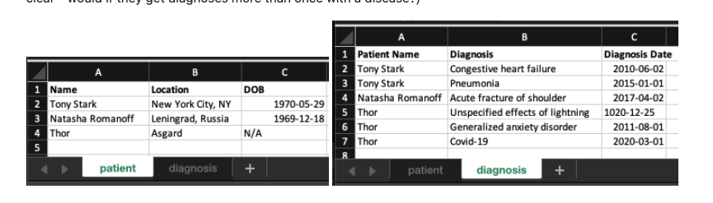
What is a database?
“Organized collection of data”
Mostly clinical databases are relational databases
Simple example: Excel spreadsheet

Slide 9
What are some problems with this “database”?

Slide 10
Principles of relational databases
Redundancy: Store patient names and diagnoses in separate tables, without duplicating
Uniqueness: Unique identifiers for entities like patients
Granularity: Break up data elements

Slide 11
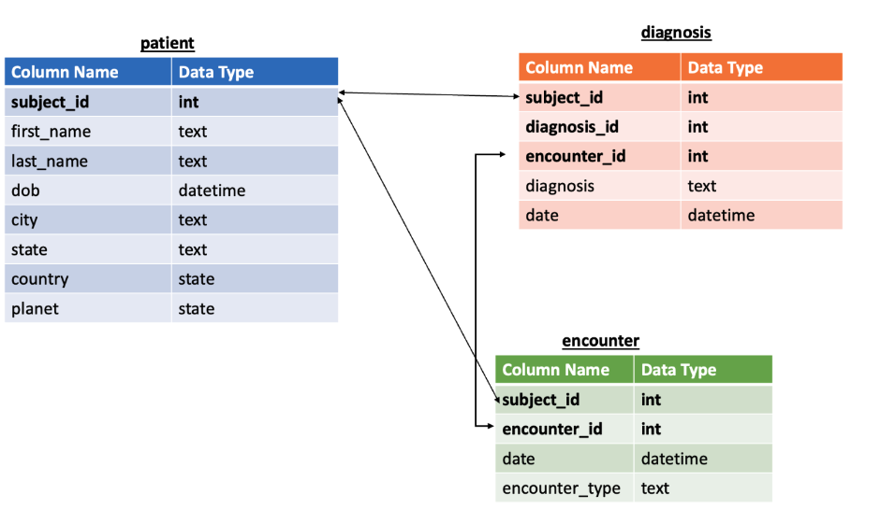
New database schema

Slide 12
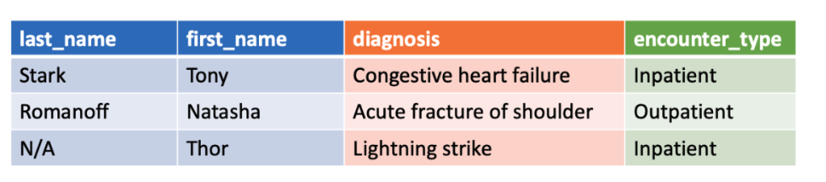
Join tables to get data for analyses

Slide 13
Question #1
Using our database schema, what columns would we need to answer the question:
“What are all the ID’s of patients who have had Covid-19?”
Subject_id
Diagnosis
Diagnosis date
Encounter date
Encounter type

Slide 14
Question #2
Using our database schema, what columns would we need to answer the question:
“How many outpatient encounters took place between January and May of 2022?”
Subject_id
Diagnosis
Diagnosis date
Encounter date
Encounter type

Slide 15
Question #2
Using our database schema, what columns would we need to answer the question:
“What is the average age of diagnosis for patients with cancer?”
Subject_id
Diagnosis
Diagnosis date
Encounter date
Encounter type

Slide 16
III. MIMIC database with SQL

Slide 17
MIMIC-III database
De-identified clinical database
Critical care hospitalizations at Beth Israel between 2001 and 2012
Many types of clinical data
Full dataset available with data usage agreement; sample of 100 patients available as demo

Slide 18
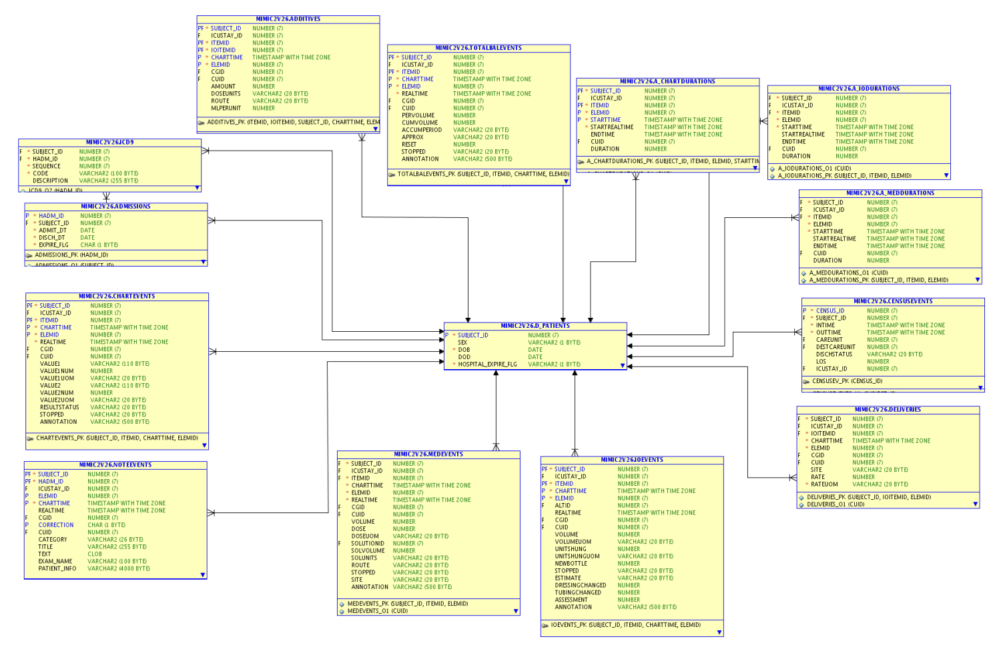

Slide 19
Instructions for coding activity
Download the following files from Canvas:
mimic_demo.db
1 Intro to SQL with MIMIC.sql
2 Aggregating Data.sql
3 Diagnosis Codes.sql
Go to our online SQL browser: https://sqliteonline.com/
Upload mimic_demo.db and the files

